Slide 1

DNS AND NFS SERVER CONFIGURATION USING UBUNTU
PRESENTED BY:
MD. HAFIZUR RAHMAN ARFIN (161-15-7144)
MAJEDUL ISLAM RIFAT (161-15-6784)

Slide 2
OUTLINE:
1. Introduction
2. NFS Server
3. NFS Server configuration
4. DNS server
5. DNS server configuration
6. Conclusion

Slide 3
1.
INTRODUCTION MD. HAFIZUR RAHMAN ARFIN
LET’S GET TO KNOW THE BASICS – UBUNTU, SERVER AND SERVER CONFIGURATION

Slide 4

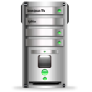
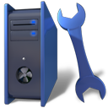
UBUNTU?
Ubuntu is a free and open source operating system and Linux distribution based on Debian.
SERVER?
A computer or computer program which manages access to a centralized resource or service in a network.
UBUNTU SERVER CONFIGURATION?
Configuring Ubutu computer to act as a server providing various services. For example Ubuntu computer providing DNS services.

Slide 5

A quality that includes the essential human virtues; compassion and humanity.

Slide 6
2.
THE NFS SERVER MD. HAFIZUR RAHMAN ARFIN
WHAT IS NFS SERVER, WHATS IT’S BENEFITS

Slide 7


Network File System
Network File System is a distributed file system protocol originally developed by Sun Microsystems in 1984, allowing a user on a client computer to access files over a computer network much like local storage is accessed.
Why NFS?
NFS allows local access to remote files.
It uses standard client/server architecture for file sharing between all *nix based machines.
With NFS it is not necessary that both machines run on the same OS.
With the help of NFS we can configure centralized storage solutions.
Users get their data irrespective of physical location.

Slide 8
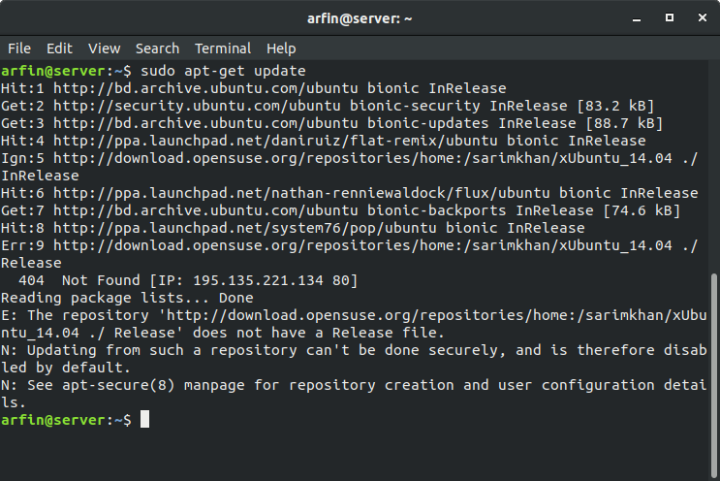
Place your screenshot here
3.
CONFIGURING
NFS SERVER MD. HAFIZUR RAHMAN ARFIN

Slide 9
Initialization
Update repositories
Command: sudo apt-update
Install NFS server package
sudo apt-get install nfs-kernel-server

Slide 10
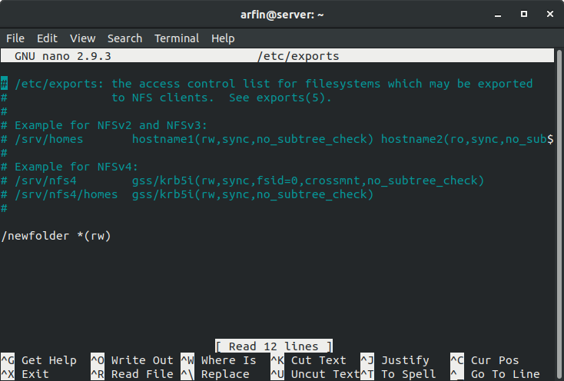
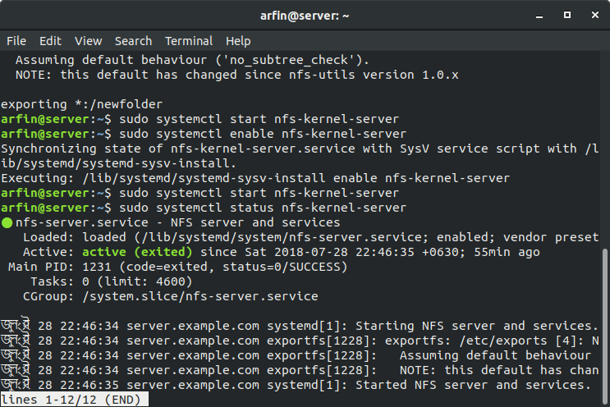
Configuring Server side
Create a folder in NFS to share and giving permissions
Command: sudo mkdir /newfolder
Command: sudo chmod 777 /newfolder
Editing the configuration files in export directory using Nano
Command: sudo nano /etc/exports
Save and exit from nano
Initialize the configuration files
sudo exportfs –arvf
Start NFS Service and check status
Command: sudo systemctl start nfs-kernel-server
Command: sudo systemctl status nfs-kernel-server command is needed to be used

Slide 11
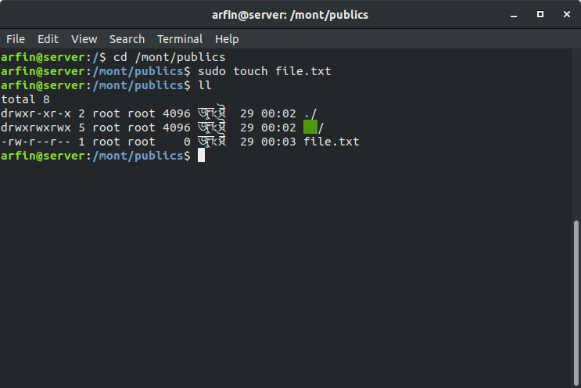
Configuring Client side
Install package
Command: sudo apt-get install nfs-common
Command: showmount –e 192.168.1.105
Creating a directory for mounting
Command: sudo mkdir /mont/public
Mounting the nfs folder in the client side
Command: sudo mount –t nfs 192.168.1.105:/public /mont/newfolder
Creating file in NFS mounted folder and creating the file
Command: cd /mont/public
Command: sudo touch file.txt
Successfully created a .txt file from the client side to server side

Slide 12
4.
THE DNS SERVER MD. MAJEDUL ISLAM
WHAT IS NFS SERVER, WHATS IT’S BENEFITS

Slide 13
DOMAIN NAME SERVICE
Domain Name Service (DNS) is an Internet service that maps IP addresses and fully qualified domain names (FQDN) to one another. In this way, DNS alleviates the need to remember IP addresses. Computers that run DNS are called name servers. Ubuntu ships with BIND (Berkley Internet Naming Daemon), the most common program used for maintaining a name server on Linux.
Why DNS?
As a cache to improve performance.
We want to name some computers that are only available in the LAN . Some of our servers can only be accessed from the internal network, we want our users to be able do it with a normal name using the same tools that they are used.
We give different IPs to some names.
To temporary ban some domain names, sometimes we need to ban for a couple of minutes some website, an easy way to do it is to change the IP it's pointing..
DNS is like a phone book for the Internet.

Slide 14
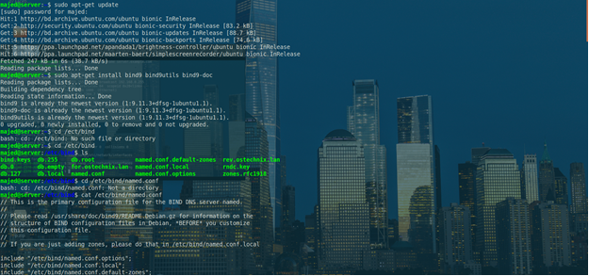
Place your screenshot here
5.
CONFIGURING
NFS SERVER MD,MAJEDUL ISLAM

Slide 15
Initialization
Update repositories
Command: sudo apt-update
Install Bind9 server package
sudo apt-get install bind9 bind9utils

Slide 16
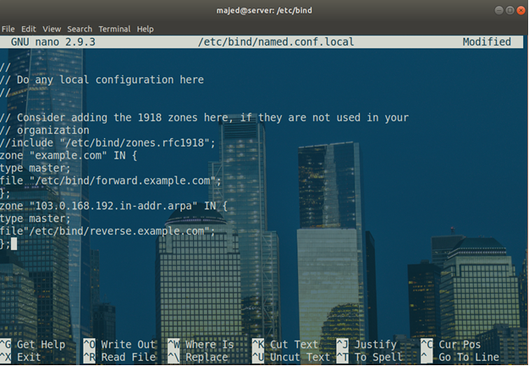
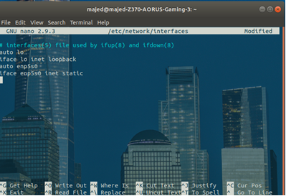
Configuring Server side
Then we’ll need to edit the interfaces of our network Command: CAT /etc/bind/named.conf
Editing the configuration files in ‘/etc/bind/named.conf’ using nano directory using Nano
Command: sudo nano /etc/bind/named.conf
Save and exit from nano
We have edited the name.conf.local with the 2 zones
sudo nano /etc/bind/named.conf.local
Now we started the bind server – sudo systemctl start bind9
Then we’ll have to ownership of the files to bind using – sudo chown –R bind:bind /etc/bind

Slide 17
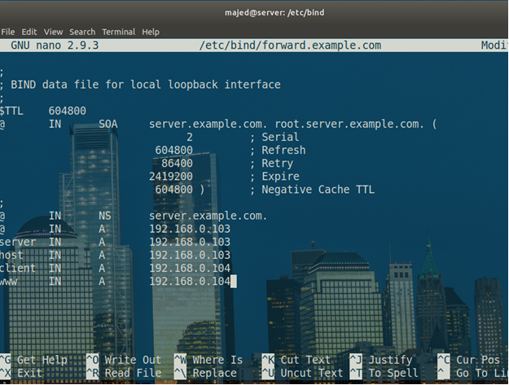
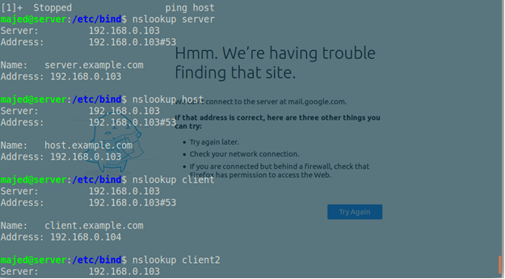
Configuring Client side
Now we started the bind server –
Command: sudo systemctl start
Now we’ve pinged, using–
Command: ping server
Then we’ve pinged using–
Command: ping host
checke the dns lookup using–
Command: nslookup server
checke the dns lookup using–
Command: nslookup server

Slide 18
6.
Conclusion MD,MAJEDUL ISLAM

Slide 19
Conclusions:
First it looked Tough
Need to be familiarized with ubuntu os
NFS and DNS are both very important servers in the server world
Through this project we've learned a lot about these things

Slide 20
References
What is Ubuntu? - https://help.ubuntu.com/lts/installation-guide/s390x/ch01s01.html
Network File System (NFS) - https://help.ubuntu.com/lts/serverguide/network-file-system.html.en
Configure Ubuntu NFS Server - https://www.youtube.com/watch?v=FW3eRvr1v8Q
How to configure Netwok file Sharing Server (NFS Server) in Ubuntu Linux 18.04 - https://www.youtube.com/watch?v=SpYTsRk3Dkk&t=244s
How to configure DNS Name Server in Ubuntu Linux 18.04

Slide 21
THANKS!
Any questions?

